Slide 1
Unit 3 - Lesson 5
The Need for Programming Languages

Slide 3
Unit 3 Lesson 5 - Warm Up
Prompt:
Write down three different reasons you would call a set of instructions "bad".
Be ready to share with a neighbor.

Slide 5
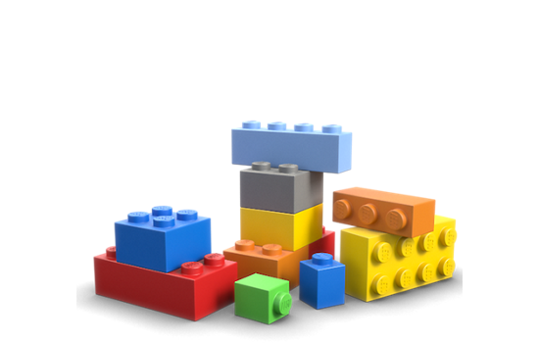
Unit 3 Lesson 5 - Activity
You and your partner should have:
Pen / Pencil
Sheet of paper
A small set of Legos or other blocks
Notes:
Supplies: Red and orange sticky notes
Snack-sized baggies
Dry erase markers
Pens/pencils

Slide 6
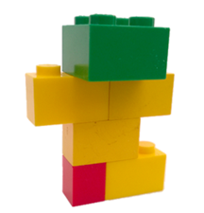
Unit 3 Lesson 5 - Activity
Step 1: Design
Put 5-6 pieces together
All pieces must be connected
Step 2: Record
Take a photo or draw a picture
Color matters
Step 3: Write instructions
Write instructions for building your design
Be as clear and precise as possible
Just words, no drawings, diagrams, or pictures

Slide 7
Unit 3 Lesson 5 - Activity
Step 4: Trade
Take apart your design, then trade pieces and instructions with another group
Step 5: Build
Try to build the design following the instructions
Step 6: Compare
Compare your design to the picture the other team recorded
Step 7: Repeat
If you have time try this activity with one or two other groups’ instructions.

Slide 9
Unit 3 Lesson 5 - Wrap Up
Prompt:
When you or your classmates made mistakes following instructions today what "went wrong"? Try to be as specific as possible.

Slide 10
Unit 3 Lesson 5 - Wrap Up
Prompt: Imagine we were going to redesign human language to be really good for giving clear instructions. What types of changes would we need to make?

